Slide 1

Computational Photography
Assignment #1: Epsilon Photography
Prakash Bhatta
Fall 2019

Slide 2
Report Guidelines
You must use the templates provided for your report, but you may customize them (reduce font size, reply in paragraph or column formats, add illustrations and extra images to aid your explanations, change the background, delete notes such as this page, etc.). You may delete optional slides if they are unused in your report.
Remove instructor notes or instructions (usually in red) from your reports (but keep question prompts).
Replace lighter blue typing with your answers
You may add pages as necessary to best present your work. We like images, but resize each image to 2MB or less before pasting them into the template to reduce file size and make grading easier.
We expect graduate-level answers that provide clear explanations. Short, simplistic answers will not receive full credit. You may need to do research beyond just watching the class videos and reading the technical resource papers.
When you are done, convert your template report to PDF and then check it! Students often end up with lines cut off on page bottoms, and we will not accept replacement work. We can only grade what appears in the report.
DELETE THIS SLIDE

Slide 3
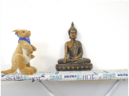
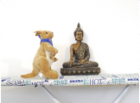
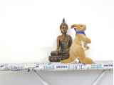
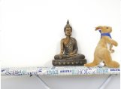
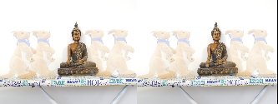
Epsilon Project Overview
Image 1
Image 2
Image 3
Image 4
Description:
Couple bunnies hand holding and taking a walk at monastery. Individual bunny pictures are blended and combined to get a final filtered artifact. Here I have taken 4 pictures to give final picture.
Include a short description of your project. Provide at least 2-3 sentences.
Final Artifact

Slide 4
Project Discussion
What is your epsilon parameter? Viewpoint. The bunny is moved in each picuture.
Location of pictures? Maryland Heights, Missouri
Date and time? August 28, 2019 from 3.00pm to 5.00pm
How did you control the settings, the environment, and the camera to meet your epsilon requirement?
In this project, I wanted to keep all my camera parameters (Exposure time, ISO, Focal distance, aperture etc.) constant and move the object(view point) to create a blended final artifact where the objects that are represented in each picture are displayed in the final picture. To make it more real, I wanted to apply this setting in open grass ground but due to the color settings, the final artifact did not look clear. Hence I switched pictures in a room settings. I had used my samsung note8 camera for taking all the pictures. I used an android app called “Open Camera” to control the parameters and lock my camera settings. For picture alignment and camera stability, I had used a simple tripod. Discuss your project. This may include personal motivation as well as your technical goals. Include difficulties you faced, such as camera stability, image alignment, or others.
Use graduate-level writing. Be detailed; use additional pages as necessary.

Slide 5
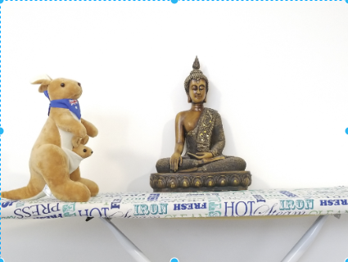
Image 1
Describe this photo and provide camera settings
Description:
Here in this image, the bunny is at the leftmost of the stand. Buddha sculpture lies at the middle of the stand.
Camera settings:
Exposure: 1/7 s
Aperture: f/1.7
ISO: 205
Focal Length: 4.3mm
Bunny position: Left most
Note that only one thing should be changing!

Slide 6
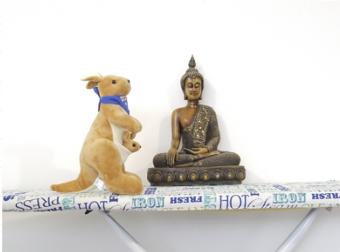
Image 2
Describe this photo and provide camera settings
Description:
Here the picture is moved about 5-10 inches to the right. The only moving piece is the bunny.
Camera settings:
Exposure: 1/7 s
Aperture: f/1.7
ISO: 205
Focal Length: 4.3mm
Bunny position: Left
Note that only one thing should be changing!

Slide 7
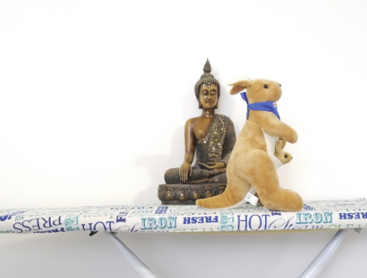
Image 3
Describe this photo and provide camera settings
Description:
Here in this image, the bunny is moved another 5-10 inches to the right and it now lies at right side of the sculpture.
Camera settings:
Exposure: 1/7 s
Aperture: f/1.7
ISO: 205
Focal Length: 4.3mm
Bunny position: right
Note that only one thing should be changing!

Slide 8
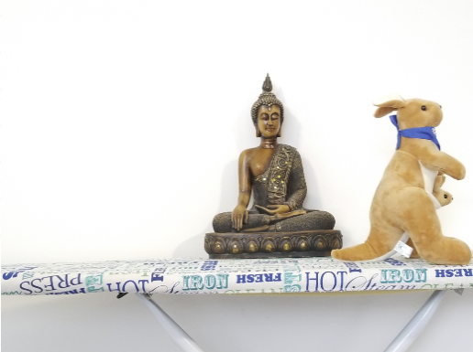
Image 4
Describe this photo and provide camera settings
Description:
Here in this image, the bunny is moved another 5-10 inches to the right and it now lies at right most side of the sculpture.
Camera settings:
Exposure: 1/7 s
Aperture: f/1.7
ISO: 205
Focal Length: 4.3mm
Bunny position: right most
Note that only one thing should be changing!
Include additional slides for each individual photo (maximum of 8)

Slide 9
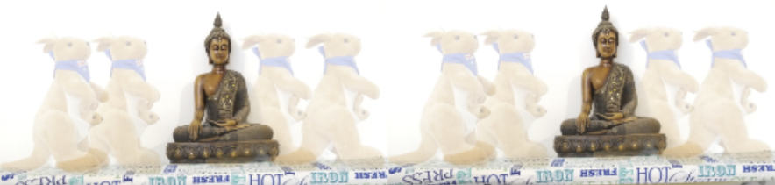
Final Artifact
Bunny couple handholding touring monastery

Slide 10
Final Artifact Details
Discuss how your final artifact demonstrates your epsilon.
My final artifact is the blended version of all individual images. Here all the camera parameters are kept constant except for the viewpoint of individual images. Different viewpoint of each images are then combined together to get the final artifact. The bunny in the picture is moved by small distance in each of the individual image which represent the epsilon for the image.
Did you do anything to prepare your N images? (e.g. cropping, alignment) If yes, describe your process and mention if you used any image editing software (e.g. Photoshop). If you did not do any processing to your N images beforehand, say so. In order to have more natural setting, I tried to take the bunny in the outside grass setting but the images did not give good clear final artifact. Hence, I took the N pictures in a room setting to get a better final artifact. For alignment and stability, I used a tripod. I used a regular android phone app “Open camera” to pick the constant camera parameter settings.
Walk through the code you wrote to create the final artifact. You may provide code snippets to help in your discussion. Do NOT just copy and paste your code with in-line comments. Explain the purpose of the code that you’re presenting.
Use additional slides as necessary

Slide 11
Project Retrospective
In what ways was your project successful?
Be descriptive. Think about the images you took, your implementation, and your final result.
If you were to repeat the project, is there anything you would do differently knowing what you do now?
There could be multiple things you would do differently. Unless your result is absolute perfection, there should be at least one thing you would do differently.

Slide 12
Other Details (Optional)
Feel free to share other thoughts associated with this picture and basic project, otherwise you should remove this slide.

Slide 13
Above & Beyond (Optional)
See the 90% rule on Piazza.
Complete the assignment first. It is more important to do well on the basic assignment for 90% of your grade.
Include images, research, and explain what you learned.
Do not just demonstrate another example similar to your first one, do something different; e.g. a different epsilon or very different Final Artifact. Perhaps implement another way to combine a different set of images using original code
Technical discussion is critical for high grades.
Quality matters.
Highest grades are reserved for reports that make us say “Wow!”
Include your references on the Resource page.
Use as many pages as necessary, titled Above & Beyond.

Slide 14
Resources
Record your sources here. We accept all reasonable formats that would allow us to verify your sources. Our class lectures do not have to be referenced. If you are reusing your work from a prior semester, mention it here.
Piazza posts
Websites
Textbook
?
It is plagiarism if you don’t reference your sources!

